Slide 1
Welcome to NextHike Solutions
Bike Sharing Analysis Project
Shahrukh Shaikh
23-10-2025

Slide 2
Problem Statement
Summary:
I studied bike-sharing data to understand how rentals vary with weather, time of day, and holidays, and to compare casual and registered users. This helps improve planning and daily operations.
Impact of weather, time, holidays on rentals
Patterns of Casual vs Registered users
Goal: Improve planning & decision-making

Slide 3
Dataset Overview
Summary:
I combined three datasets containing hourly and daily rentals with weather and user information to create a unified dataset for analysis
Sources: Dataset_1, Dataset_2, Dataset_3
Columns: dteday, hr, temp, humidity, windspeed, user_type, cnt
Data type: Hourly & daily bike rentals

Slide 4
Data Cleaning & Preparation
Summary:
The data was cleaned and new calculated columns were added to ensure accuracy and make analysis easier. Weekdays were labeled to help visualize trends more clearly.
Handled missing values and duplicates
Created calculated columns: Weekday, Weekend/Weekday, 7-day Moving Avg
Converted day numbers to weekday names (Day)

Slide 5
Key Analysis
Summary:
Bike rentals are highest in the morning and evening, peak on weekdays, and differ by user type—registered users ride more on weekdays, while casual users ride more on weekends. Rentals decrease in bad weather, and warmer temperatures increase demand.
Hourly Trends: Peak at 7–9 AM & 5–7 PM
Weekday Patterns: Highest rentals on weekdays
User Comparison: Registered > Casual (weekdays), Casual > Registered (weekends)
Weather Impact: Lower rentals on rainy/cold days
Correlation: Temp positively correlated with rentals

Slide 6
Heatmap Insights
Summary:
The heatmap visually shows bike rentals across the week, highlighting the busiest hours. Weekdays have commuting peaks in the morning and evening, while weekends peak around midday. This insight helps plan bike availability, staffing, and operations more effectively
Heatmap: Day of Week vs Hour
Darker colors = higher demand
Observations: Morning/evening peaks on weekdays, midday peaks on weekends

Slide 7
Dashboard
Summary:
The dashboard shows bike rental trends by hour, day, and weather, compares user types, and highlights correlations with temperature, humidity, and wind. The heatmap identifies peak hours, and the forecast predicts future rentals to support planning and operations.
Interactive Excel dashboard with:
Line, Bar, Column charts, Histogram Chart
Pivot Tables: Rental by Hours, Average Rental Comparision, Weekdays Rental Comparision, Rental by Weathersit
Correlations : Temperature Correlation Chart, Hum Correlation Chart, Windspeed Correlation
Heatmap : Day of Week vs Hour (Darker colors = higher demand)
Forecast : Forecasted Future Rentals

Slide 8
Key Findings & Recommendations
Summary:
The analysis suggests aligning bike availability with peak hours and user patterns, promoting casual rentals on weekdays, and planning operational activities around weather conditions.
Registered users dominate weekdays; casual users dominate weekends
Peak hours match commute times
Rentals drop in bad weather
Recommendation
Optimize bike availability during peaks
Promote weekday casual rentals
Plan maintenance based on weather forecasts

Slide 9
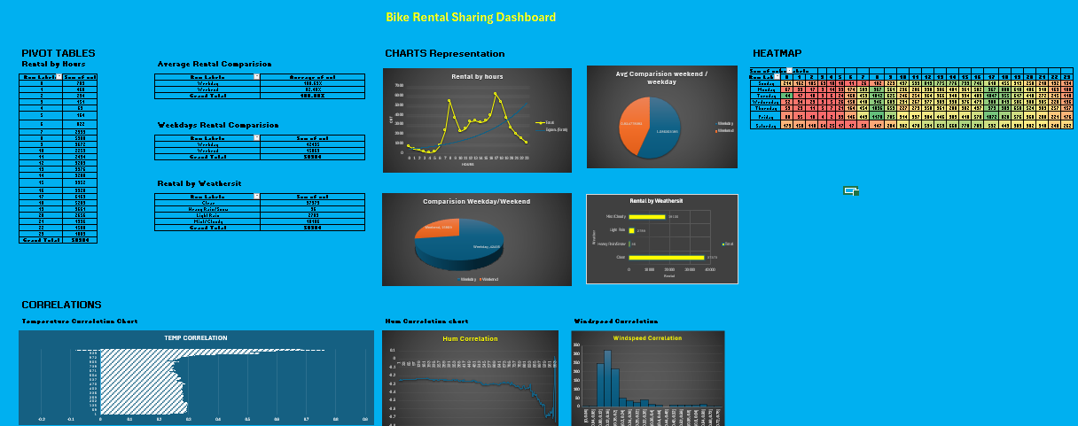
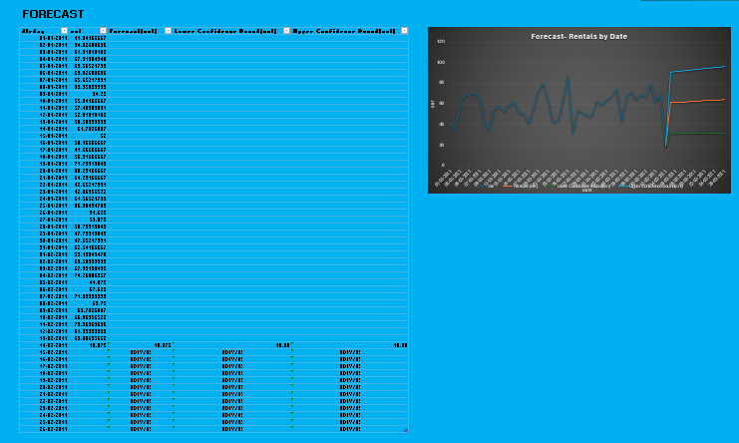
Dashboard Visuals

